Slide 1
Reflections on the pros and cons of modules, deployment mechanisms and development strategies
Paolo Spada
Centre for the Study of Democratic Institutions
Prepared for the PP conference June 12-14 2015

Slide 2
The challenge: can a survey fit them all?
Large variety of processes
Global scale
3) Large variety of disciplines, approaches and research designs
4) Different expertise and interests in the PP network

Slide 3
Can modules be the answers?
Trade-offs:
PROS
Inject flexibility and more specialization
Allow scalability
Allow the creation of multiple products for different audiences
Allow for more experimentalism
Allow more occasions for synergy with partners’ interests
CONS
Reduce comparability across cases
Generate more complexity

Slide 4
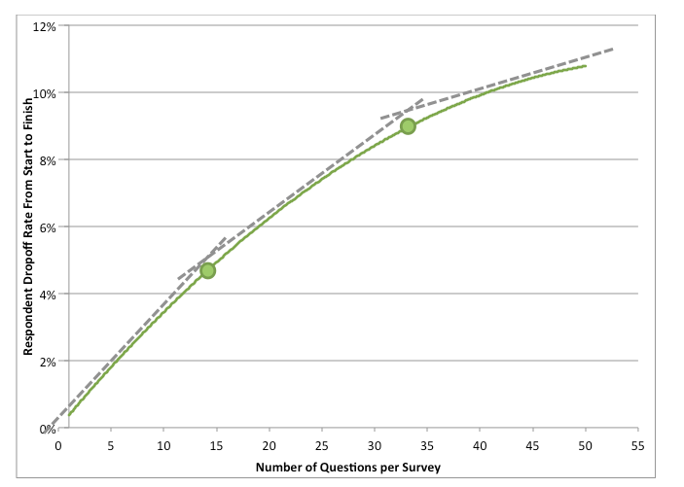
Examples of increased flexibility
a) Number of questions (e.g., create a minimal core)

Slide 5
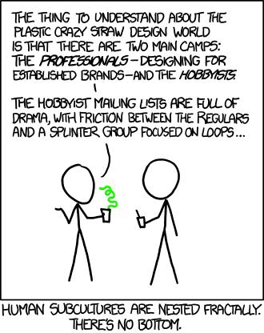
Examples of increased flexibility
a) Number of questions (e.g., create a minimal core)
b) Type of respondent (e.g., participant vs organizer vs other; academic expert vs academic non-expert; practice expert vs practice non-expert).

Slide 6
Examples of increased flexibility
c) Special topic (e.g., some researchers might be interested in exploring advanced psychometrics)
a) Number of questions (e.g., create a minimal core)
b) Type of respondent (e.g., participant vs organizer vs other; academic expert vs academic non-expert; practice expert vs practice non-expert).

Slide 7
Examples of increased flexibility
a) Number of questions (e.g., create a minimal core)
b) Type of respondent (e.g., participant vs organizer vs other; academic expert vs academic non-expert; practice expert vs practice non-expert).
d) Deployment method (e.g., single vs multiple)
c) Special topic (e.g., some researchers might be interested in exploring advanced psychometrics)

Slide 8
Examples of increased flexibility
a) Number of questions (e.g., create a minimal core)
e) Primary research method (e.g., qualitative vs quantitative)
b) Type of respondent (e.g., participant vs organizer vs other; academic expert vs academic non-expert; practice expert vs practice non-expert).
d) Deployment method (e.g., single vs multiple)
c) Special topic (e.g., some researchers might be interested in exploring advanced psychometrics)

Slide 9
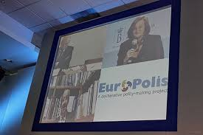
Examples of increased flexibility
a) Number of questions (e.g., create a minimal core)
e) Primary research method (e.g., qualitative vs quantitative)
b) Type of respondent (e.g., participant vs organizer vs other; academic expert vs academic non-expert; practice expert vs practice non-expert).
d) Deployment method (e.g., single vs multiple)
f) Famous methodologies (e.g., PB, CA, DP, CJ, ICT)
c) Special topic (e.g., some researchers might be interested in exploring advanced psychometrics)

Slide 10
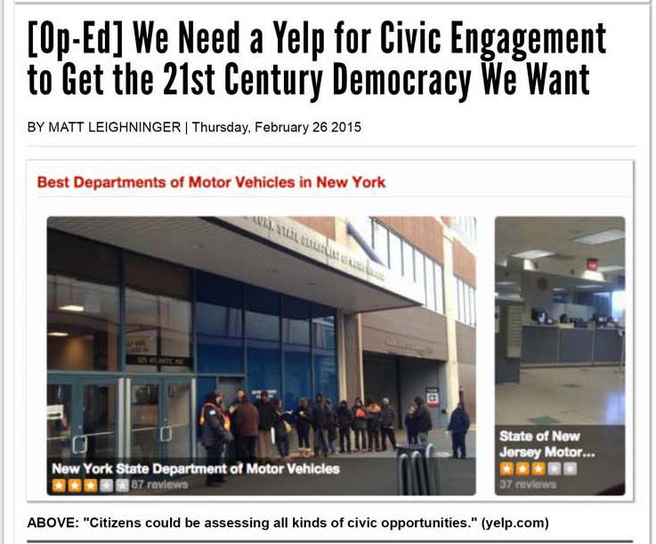
Examples of increased flexibility
a) Number of questions (e.g., create a minimal core)
e) Primary research method (e.g., qualitative vs quantitative)
b) Type of respondent (e.g., participant vs organizer vs other; academic expert vs academic non-expert; practice expert vs practice non-expert).
d) Deployment method (e.g., single vs multiple)
f) Famous methodologies (e.g., PB, CA, DP, CJ, ICT)
c) Special topic (e.g., some researchers might be interested in exploring advanced psychometrics)
g) Mapping & engagement purpose (e.g., yelp for democracy)

Slide 11
Examples of increased flexibility
a) Number of questions (e.g., create a minimal core)
e) Primary research method (e.g., qualitative vs quantitative)
b) Type of respondent (e.g., participant vs organizer vs other; academic expert vs academic non-expert; practice expert vs practice non-expert).
d) Deployment method (e.g., single vs multiple)
f) Famous methodologies (e.g., PB, CA, DP, CJ, ICT)
c) Special topic (e.g., some researchers might be interested in exploring advanced psychometrics)
h) Adapting to practitioners’ special interests (e.g., network development)
g) Mapping & engagement purpose (e.g., yelp for democracy)

Slide 12
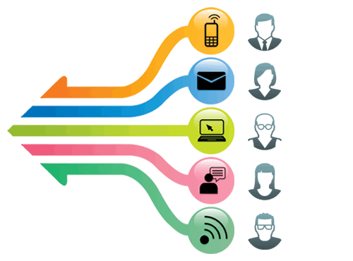
PART II: how should we deliver the survey?

Slide 13
A census of common e-survey and expert surveys delivery methods
1) Open, small/medium surveys
2) Closed, small/medium surveys
4) Surveys embedded in an online participatory event
X
3) Closed, large surveys (50 to 200 questions)
Census link: https://goo.gl/fSkd83

Slide 14
A census of common e-survey and expert surveys delivery methods
1) Open, small/medium surveys
1) Open, small surveys
They are disseminated both via websites and via email.
Given the open nature of these surveys it is impossible to judge the potential target population and the answer rate.
2) Closed, small/medium surveys
4) Surveys embedded in an online participatory event
X
3) Closed, large surveys (50 to 200 questions)
Census link: https://goo.gl/fSkd83

Slide 15
A census of common e-survey and expert surveys delivery methods
1) Open, small/medium surveys
2) Closed, small surveys
The dissemination strategy is through mail-lists or membership in an organization.
These surveys tend to target large populations. For example there was a survey on climate change that targeted the top 1% scholars in term of articles published. Answer rate varies.
2) Closed, small/medium surveys
4) Surveys embedded in an online participatory event
X
3) Closed, large surveys (50 to 200 questions)
Census link: https://goo.gl/fSkd83

Slide 16
A census of common e-survey and expert surveys delivery methods
2) Closed, large surveys
The dissemination strategy is through personal contact or membership in an organization.
Some of these employ also various forms of horizontal interactions among the experts (Delphi method and similar).
Some of these surveys contain more than 200 questions.
From what I can gather they target small (5 to 50) to medium (100 to 500) sets of experts.
1) Open, small/medium surveys
2) Closed, small/medium surveys
4) Surveys embedded in an online participatory event
X
3) Closed, large surveys (50 to 200 questions)
Census link: https://goo.gl/fSkd83

Slide 17
A census of common e-survey and expert surveys delivery methods
1) Open, small/medium surveys
2) Closed, small/medium surveys
4) Surveys that are embedded in a real life online participatory event.
The answer rate varies, I implemented one with 54% and 600 participants, but voting was tied to the survey, and one with 18% and 200,000 participants in which the survey was voluntary.
4) Surveys embedded in an online participatory event
X
3) Closed, large surveys (50 to 200 questions)
Census link: https://goo.gl/fSkd83

Slide 18
Different survey deployment methods
A single channel of survey deployment is the classic system. Currently 1800 members, ~300 case writers.
2) A non-integrated multi-channel strategy uses multiple parallel methodologies of survey deployment.
3) An omni-channel or integrated multi-channel strategy is based on an integration set of information that creates a unique ID per respondent and allows to combine information from different channels.

Slide 19
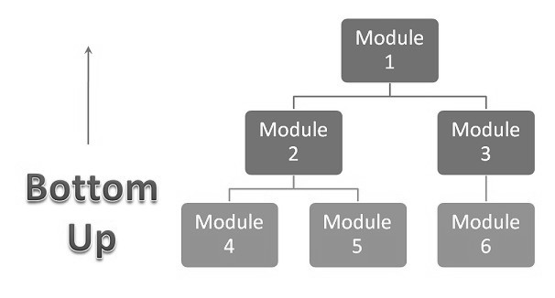
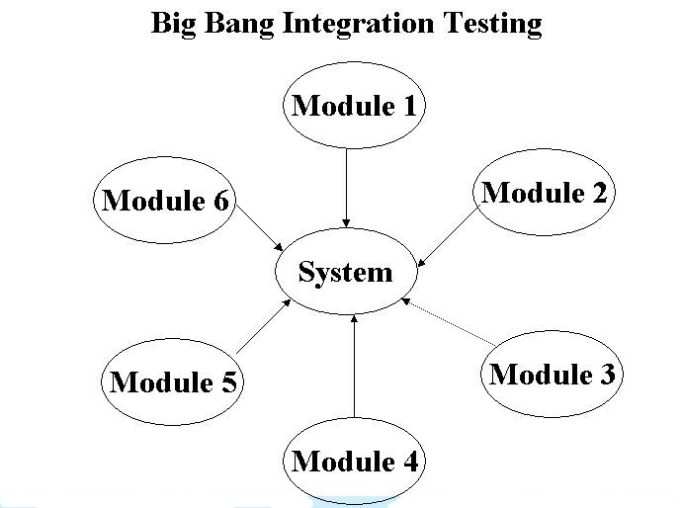
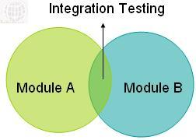
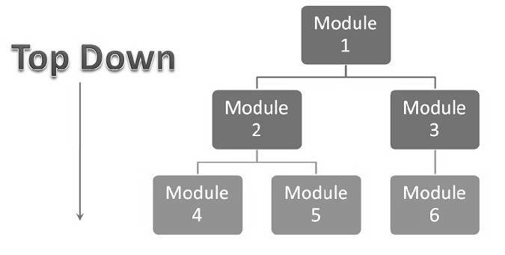
PART III: how should we integrate the modules?

Slide 20
Module Integration Approaches:
Method A: big-bang integration
Collect all the possible questions in English from all partners
Identify together a global core and an initial set of modules
Translate them to local languages and ask partners to deploy them
Collect feedback, and update the survey
Create additional modules when the necessity arises and on the basis of partners expertise

Slide 21
Module Integration Approaches:
Method B: bottom-up integration
Have partners generate modules dedicated to their expertise and regions in their own language and then translate them to English
In the short-run forego a global census, for more specialized regional and methodology specific censuses
Only later begin identifying common set of questions and synergies across regions and expertise

Slide 22
I usually cite Gramsci at the end..
…but given we got 2.5 million dollars to run this crazy project,

